Slide 1
Scriptable Objects
Advanced Unity

Slide 2
Content
Why Scriptable Objects are nice
How to create Scriptable Objects
How to use Scriptable Objects
What are Scriptable Objects
Exercise

Slide 3
Imagine that you have a RPG game with lot’s of weapons.
Each weapon has it’s own value of damage, range and speed.
How can we ensure that those values are centralized and are easily tweaked without touching the code?
Wait…why without touching the code?

Slide 4
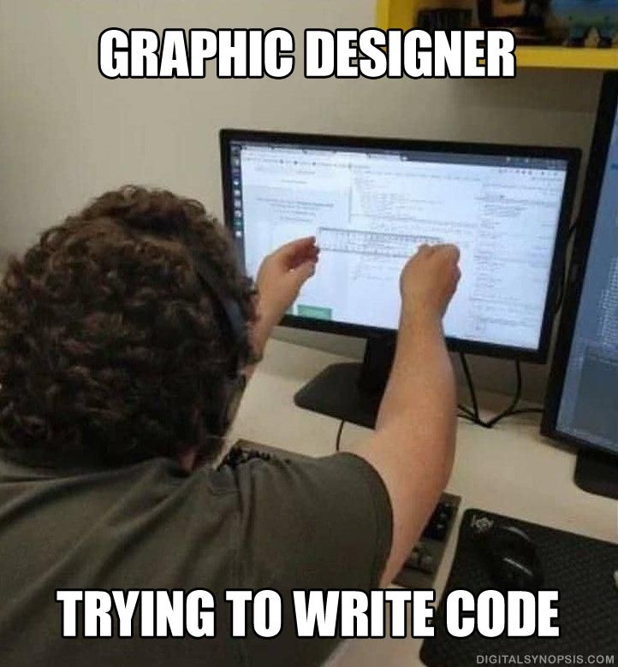

Slide 5
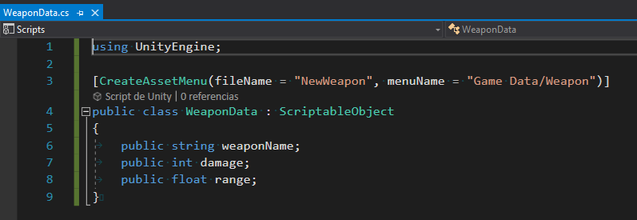
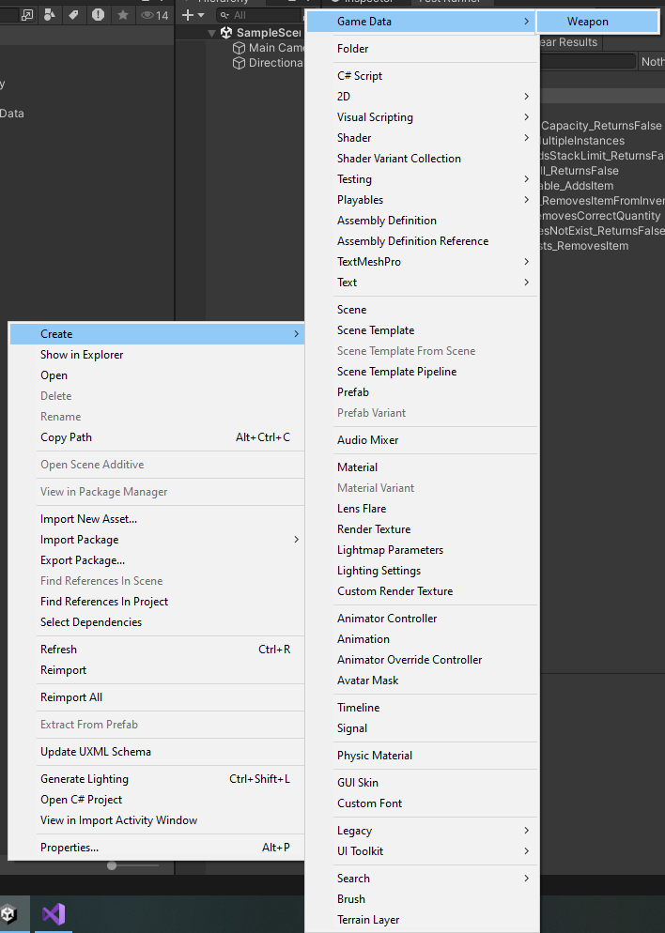

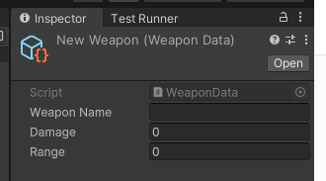
How to create a Scriptable Object
2
1
3
4

Slide 6
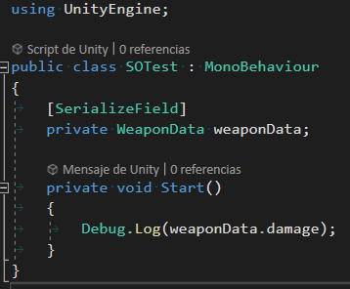
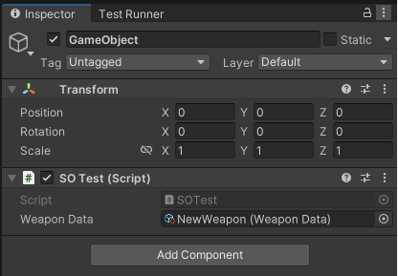
How to use a Scriptable Object

Slide 7

Okey Eric,
amazing, but actually…
Why do not simply use a non-mono c# class instead?
something like:

Slide 8
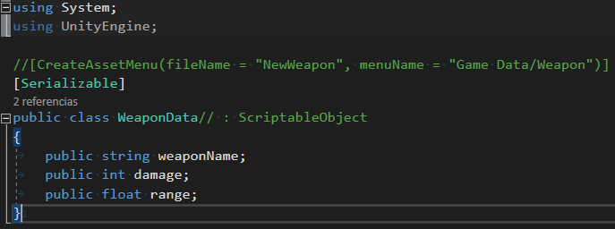
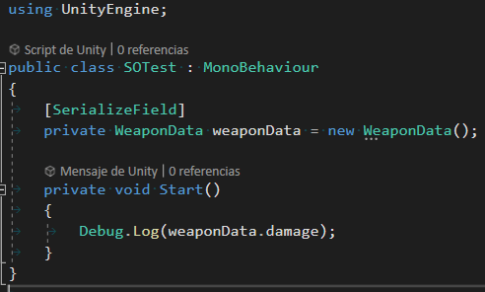
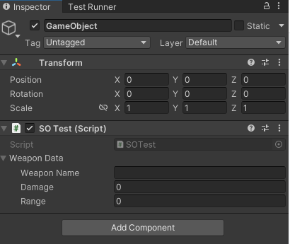

Slide 9

But…

Slide 10
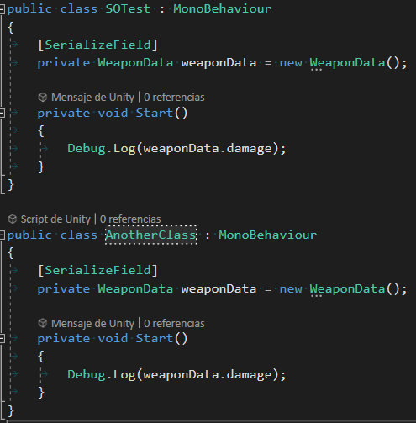
Piece of memory #1 used to store this variable
Piece of memory #2 used to store this variable

Slide 11
Piece of memory used to store this variable
That means that if you change the value of the Scriptable Object item, it will be reflected in both classes!

Slide 12
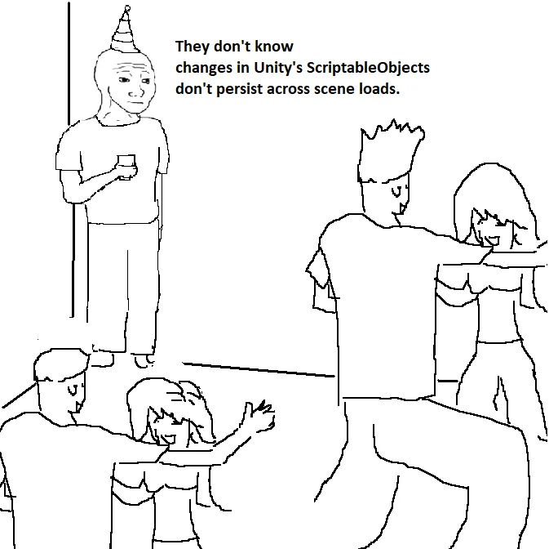
What are Scriptable Objects
SO’s are serializable data containers
They exist in the project, not the scene
That makes them independent of:
game objects
execution time
They persist outside execution time
They can be used to avoid rigid dependencies and code duplicates
Facilitate maintenance and project scalability

Slide 13

Okey okey…but I’m not a designer,
I KNOW how to code
EXERCISE!

Slide 14
Exercise
Let’s try to modify the existing project:
Increase attack damage of Archers from 1.5 to 3
Spawn two mages instead of 1
Spawn 2 archers instead of 3
Remove “Rock” from deck

Slide 15

Game Architecture with Scriptable Objects
They can be used as middle-man, to create awesome decoupled code architecture.
This video is old but gold, is a little advanced and a complete overkill, but is a pure joy to watch:
Unite Austin 2017 - Game Architecture with Scriptable Objects

